Slide 1
Agenda 9/8
Questions?
A few updates
Online Collaboration Poll Results
Drawing Activity (without Computers)
Project 1: Generative Art
Intro to p5.js
Web-editor
Grid System
Shapes, Colors, Rotate
In-class exercise #2

Slide 2
Updates
Electronic Art & Intermedia Open House Exhibition 10/21
Project Changes & Deadlines

Slide 3
Drawing Activity

Slide 4
Project 1: Generative Art
Due: 9/27 before class

Slide 5
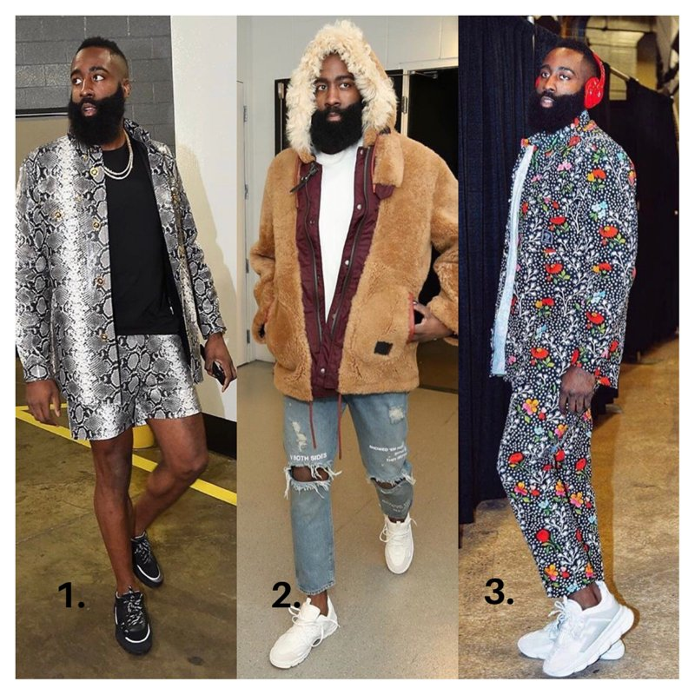
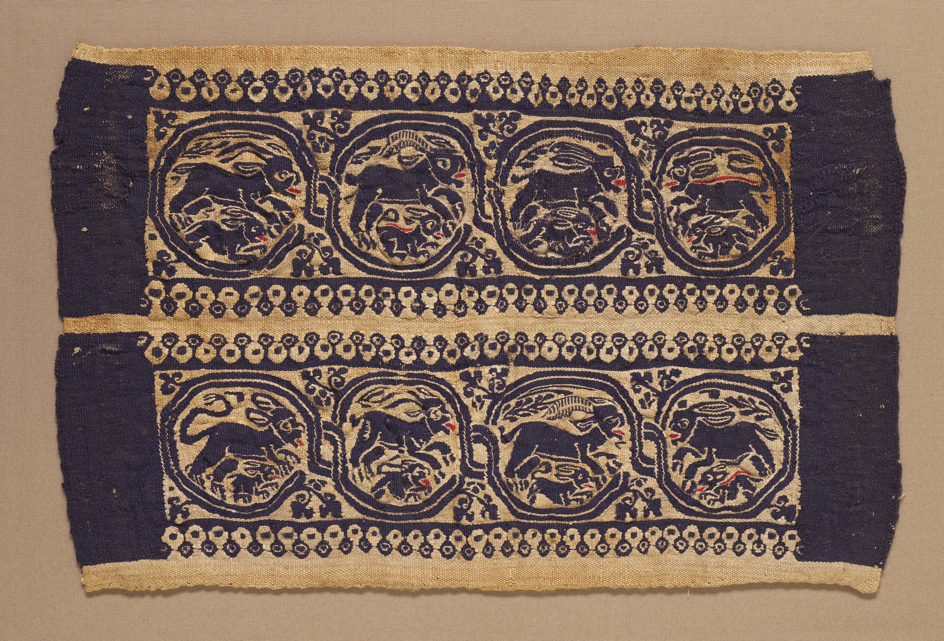
Patterns: Decoration, Ornate, Culture
Ancient Egyptian Textiles (~1500 BC)
James Harden

Slide 6
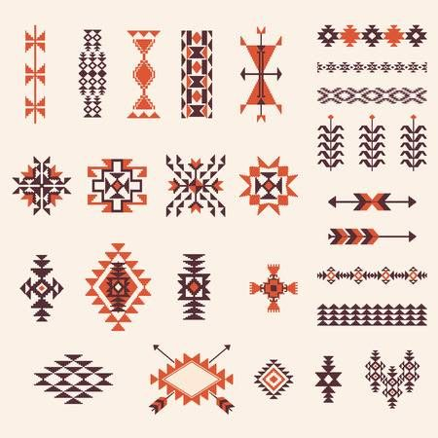
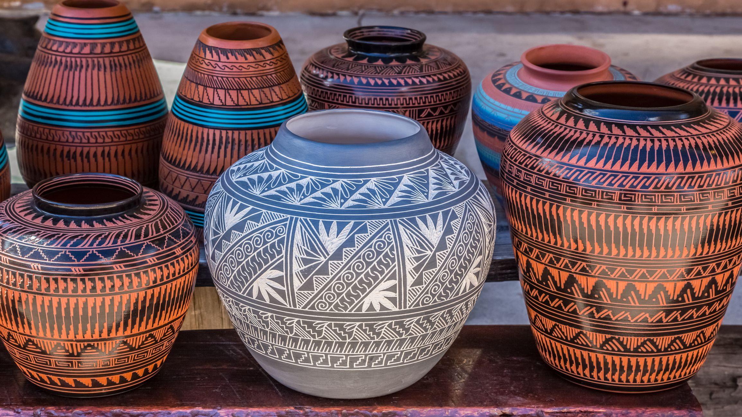
Patterns: Decoration, Ornate, Culture
Native American Crafts

Slide 7
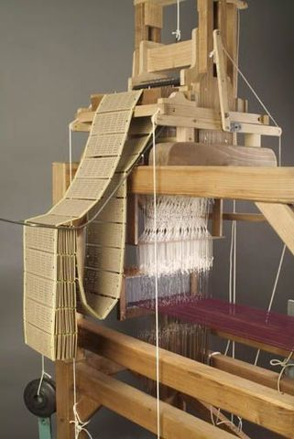
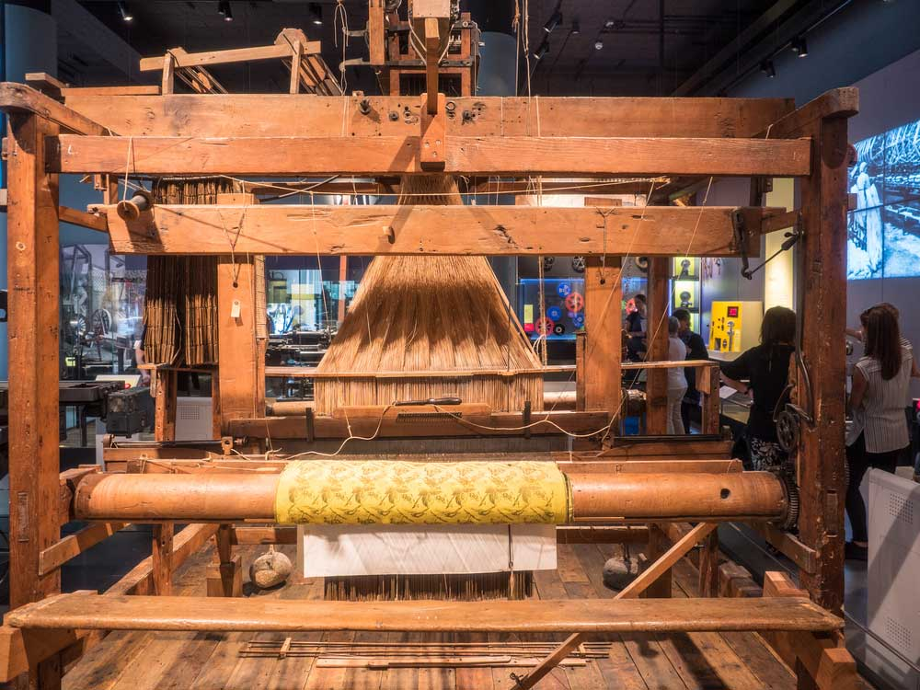
Jacquard Loom (1804) – Programmable Textile Machine

Slide 8
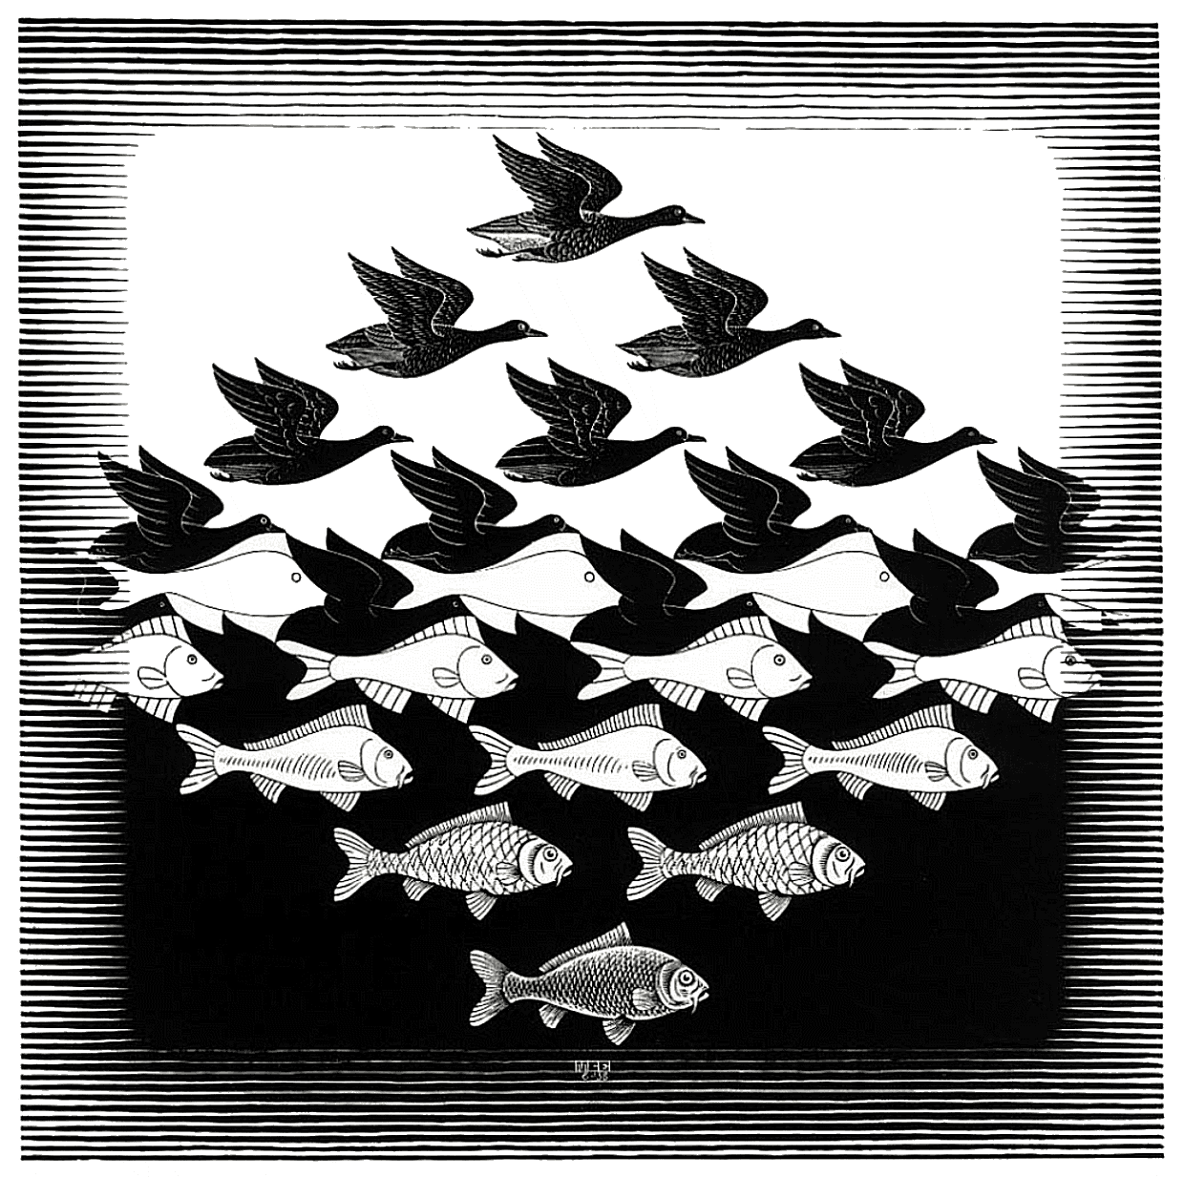
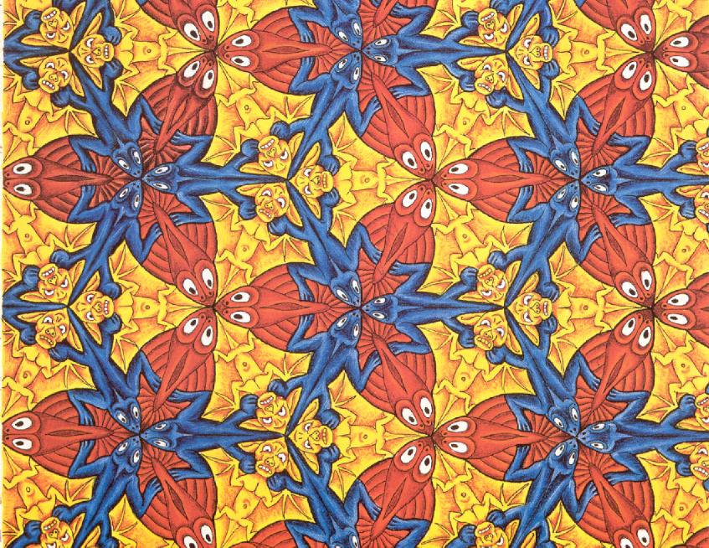
Inspiration
Escher – Tessellations

Slide 9
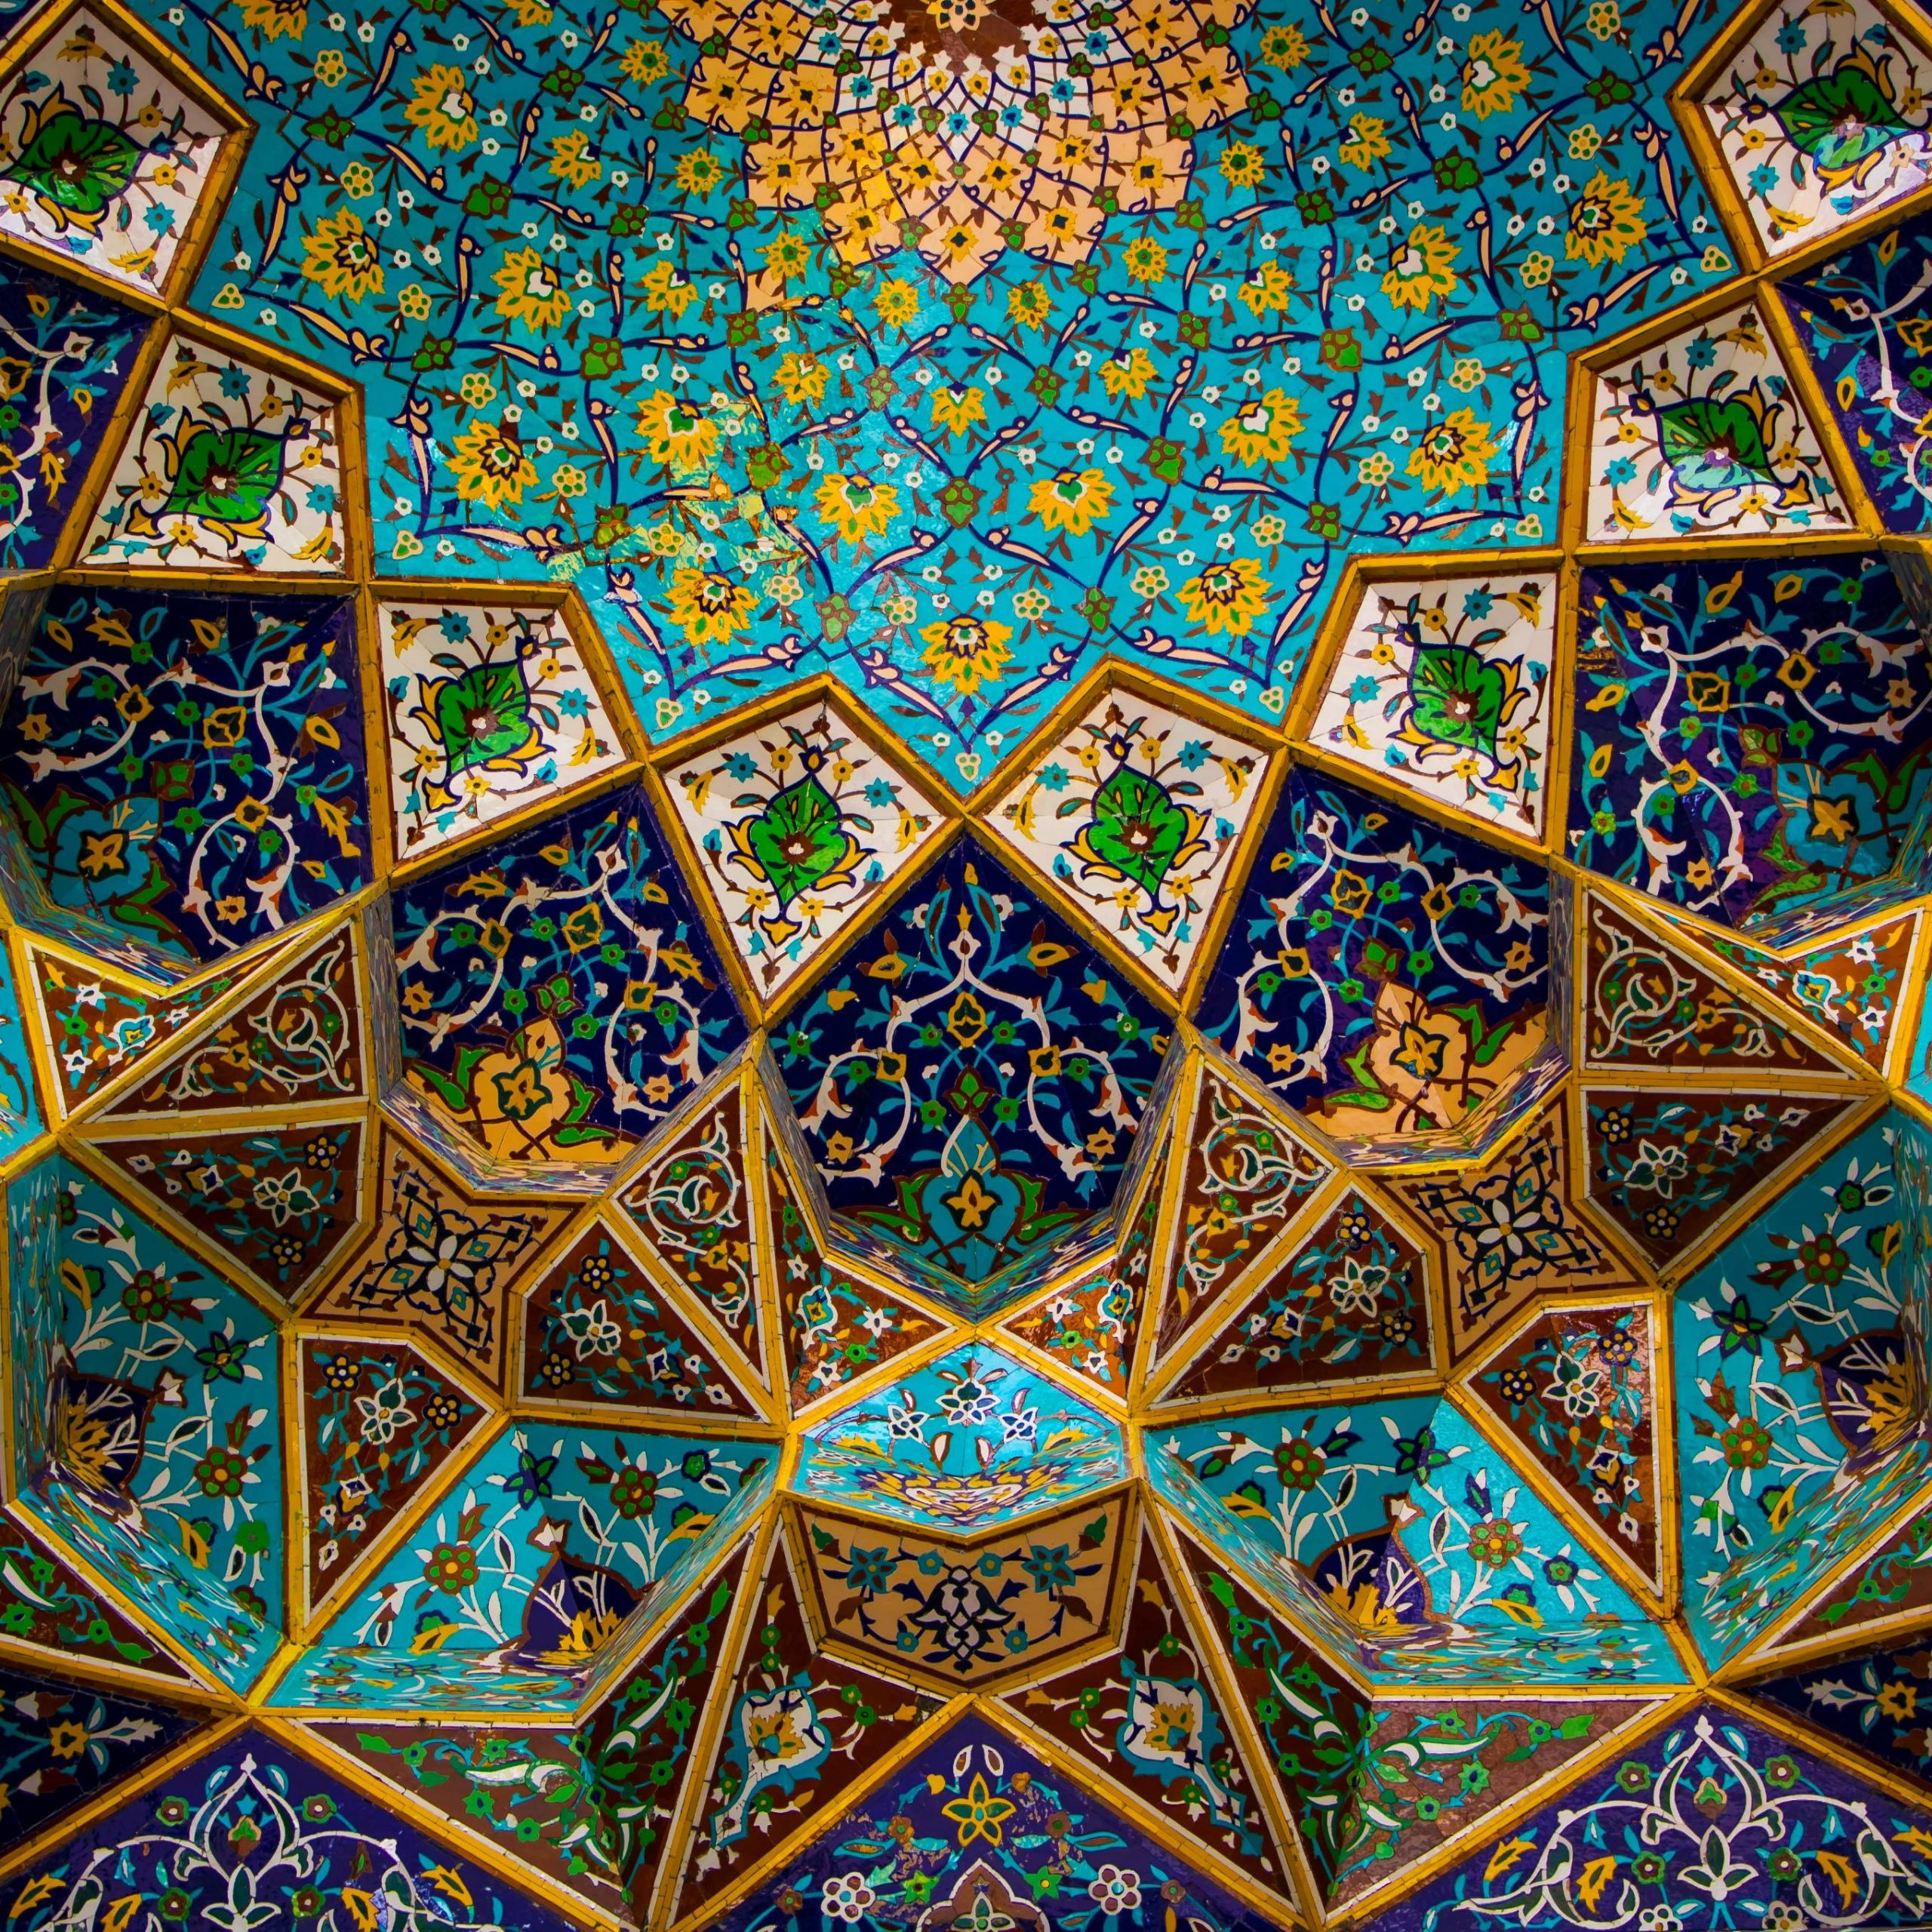
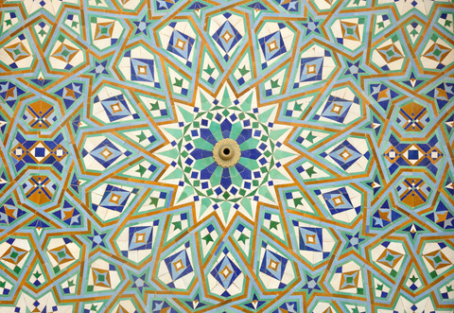
Inspiration
Islamic Art – Geometry & Patterns

Slide 10
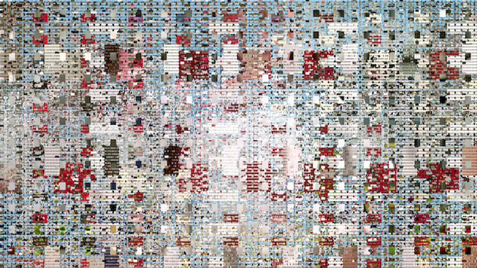
Inspiration
https://www.vice.com/en/article/9an9da/casey-reas-launches-new-exhibition-at-bitforms-gallery
Casey Reas

Slide 11
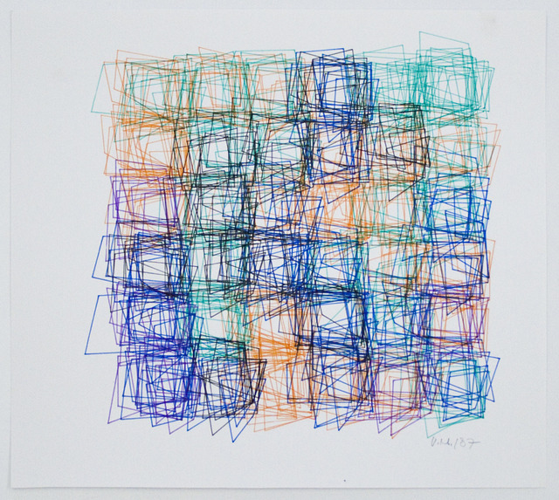
Inspiration
Vera Molnar

Slide 12
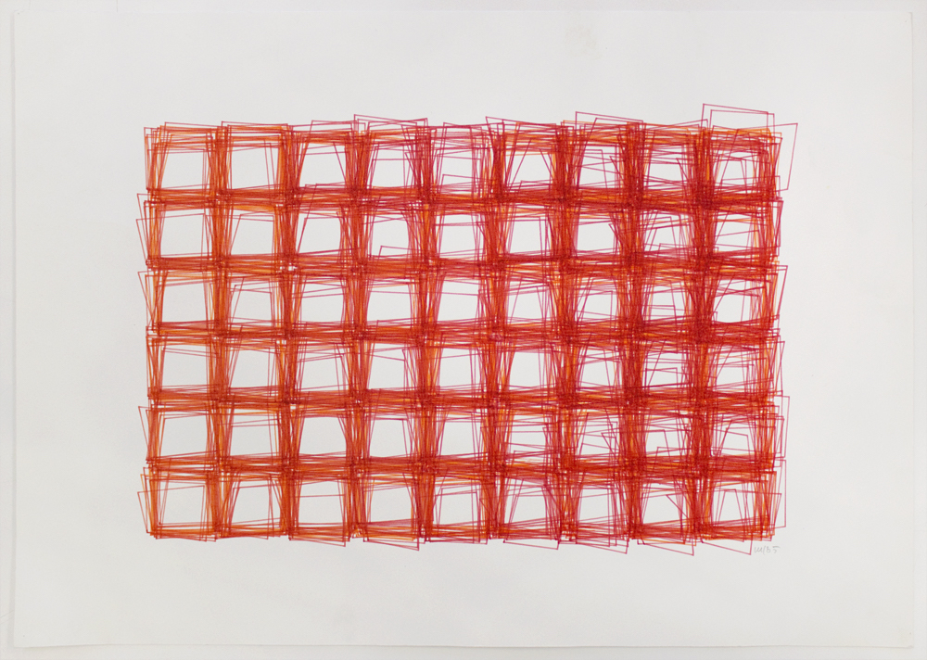
Inspiration
https://www.calvertjournal.com/articles/show/9879/this-new-york-exhibition-is-celebrating-hungarys-unsung-computer-art-pionee
Vera Molnar

Slide 13
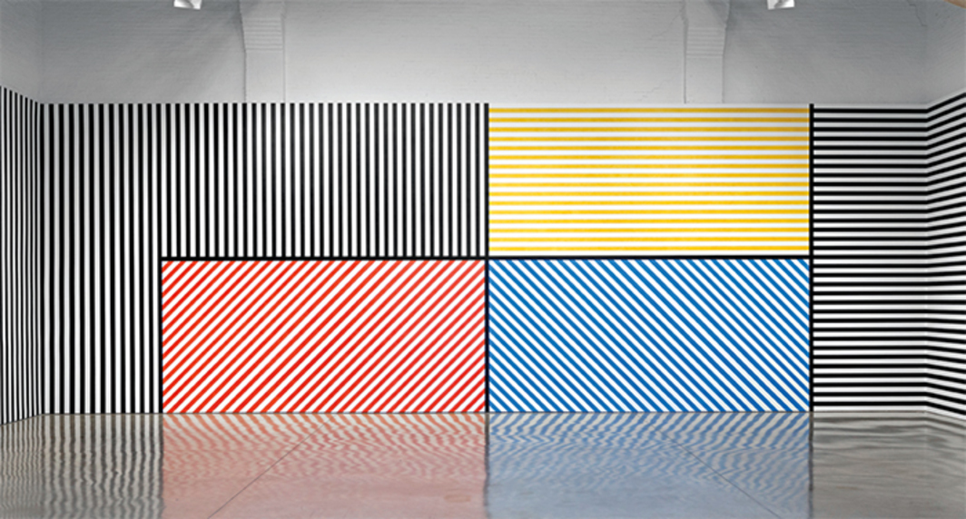
Inspiration
Sol LeWitt : Instruction Based Drawings

Slide 14
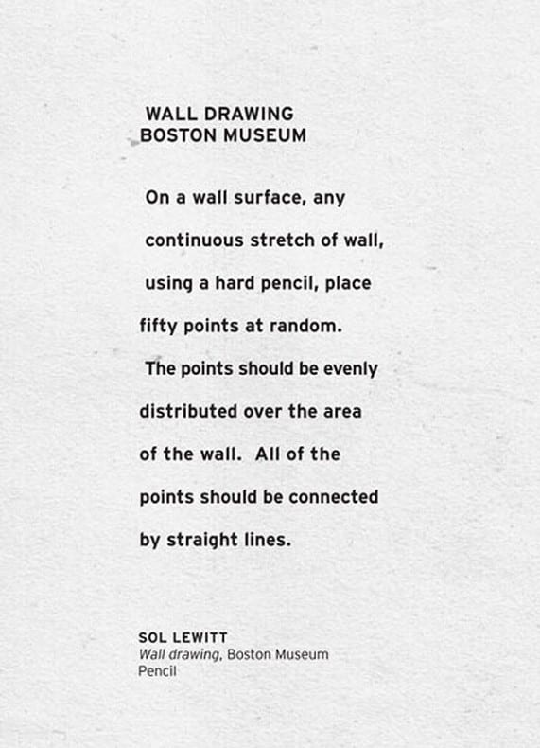
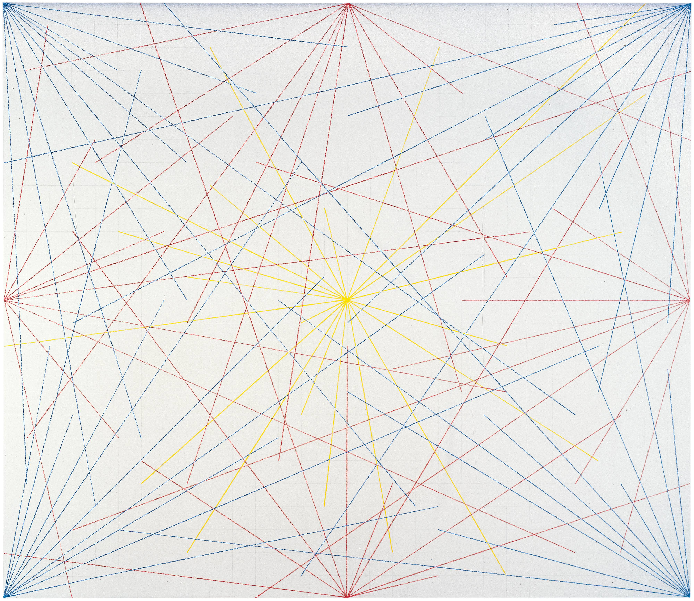
Inspiration
Sol LeWitt

Slide 15
p5.js web editor
Great way to save and share your sketches here:
https://editor.p5js.org/
Create an account now!
When submitting assignments, you can submit the link to your sketch
File > Share > Copy link to “Present”
Make sure to save your sketch first!

Slide 16
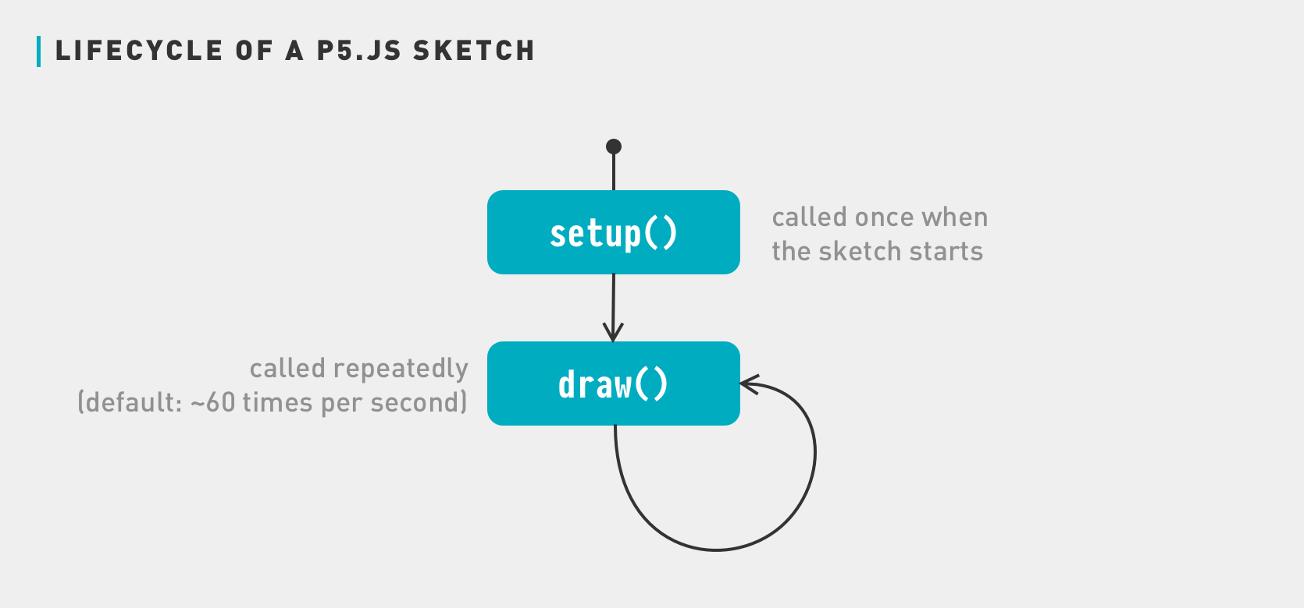
p5.js structure
https://medium.com/comsystoreply/introduction-to-p5-js-9a7da09f20aa

Slide 17
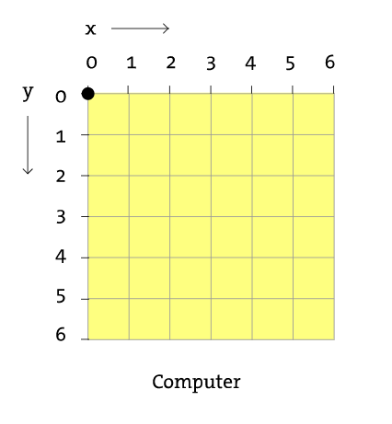
p5.js Canvas | Grid system
Pixels

Slide 18
p5.js Shapes…..but first
https://p5js.org/reference/ <- All you will ever need to know how to draw something!

Slide 19
p5.js Shapes
10, 20
rect(x, y, width, height) <- Has 4 arguments
X -> starting point of the square in x
Y ->starting point of the square in y
Width -> width of rectangle
Height -> height of rectangle
E.g.
rect(10, 20, 40, 30)
30
40

Slide 20
p5.js Shapes
Some shapes need more arguments
triangle(x1, y1, x2, y2, x3, y3)
x1 : x-coordinate of the first point
y1: y-coordinate of the first point
x2: x-coordinate of the second point
y2: y-coordinate of the second point
x3: x-coordinate of the third point
y3: y-coordinate of the third point

Slide 21
p5.js Shapes
Some shapes need less arguments
circle(x, y, d)
x : x-coordinate of the centre of the circle.
y : y-coordinate of the centre of the circle.
d : diameter of the circle.

Slide 22
p5.js Colors
Using fill before shape colors that shape
fill(r, g, b,a*)
r: red color range 0 -255
g: green color range 0 -255
b: blue color range 0 -255
a: alpha / transparency 0-255
fill(g,a*)
g: grayscale range 0 -255
a: alpha / transparency 0-255
* -optional

Slide 23
p5.js Colors
Try these other color commands
nofill()
stroke(
strokeWeight()
background()
colorMode()

Slide 24
p5.js rotate
rotate(angle) is a little tricky as it rotates the entire canvas
To use it correctly you must first move the origin to the shape you are trying to rotate with the translate(x,y)
rotate(angle) uses radian but can be used to degrees by using angleMode(DEGREES) before rotate
Since rotate(angle) will rotate the entire canvas you should use these commands between push() & pop()

Slide 25
In-class exercise#2

